Slide 1

Sports Goods Inventory Management System
Group 6

Slide 2
Group 6 HW 5
Aneesh Antony | 663970016
Megashree Maddihally Nagoji | 659020342
Sanika Kubal | 668885148
Sumedh Kumar | 663526317
Uday Kotha | 678988410

Slide 3
Project Scheduling Document
Task Name | Start Date | Assignees | Description
Initial discussion of HW5 | 3/21/2022 | Megha,Sanika,Aneesh | Discussion on how to proceed with HW5
Data Collection | 3/22/2022 | Megha,Sanika,Aneesh | Expanding our inventory management data
GUI Knowledge | 3/23/2022 | Megha,Aneesh,Sanika | GUI requirement analysis and implementation strategy
Features Improvement | 3/24/2022 | Megha,Aneesh,Sanika | Adding additional delete feature
UML Diagram | 3/25/2022 | Sanika | Creation of UML diagram for GUI
Coding | 3/26/2022 | Aneesh,Megha,Sanika | Collaborate with code knowledge and data
Testing | 3/29/2022 | Aneesh,Megha,Sanika | Collaborate for testing
Challenge Analysis | 3/30/2022 | Sanika | Problem analysis and solutions
PPT Compilation | 3/31/2022 | Megha,Sanika,Aneesh | Collaborate group data
Project Report | 3/31/2022 | Megha,Sanika,Aneesh | Final Synopsis of the HW

Slide 4

Business Operation
The activities that happen daily in the business are referred to as Business Operations. These operations drive the business.
We would have a wide variety of products in our inventory, and this would cover most of the sports.
Our business operations mainly include efficiently managing the inventory of sports goods.
The various operations in our inventory would be searching for products, listing all products in the inventory and adding the products to our inventory.

Slide 5
Business Data
Data Field | Data Type
Product ID | Integer
Product Name | String
Price | Float
Model | String
Manufacturer | String
Product Type Code | Integer
Discount Price | Float
Unit Cost | Float
Stock Quantity | Integer

Slide 6
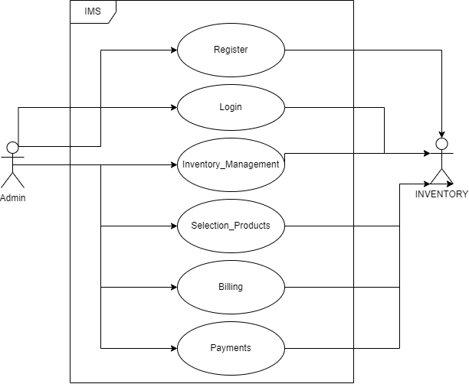
Use Case Diagram

Slide 7

Manual Documentation
IDE Used – Netbeans
Steps to Run Java GUI Application:
Open Netbeans.
Click open project and choose the provided source code.
Right click on the project folder and click on Run.

Slide 8
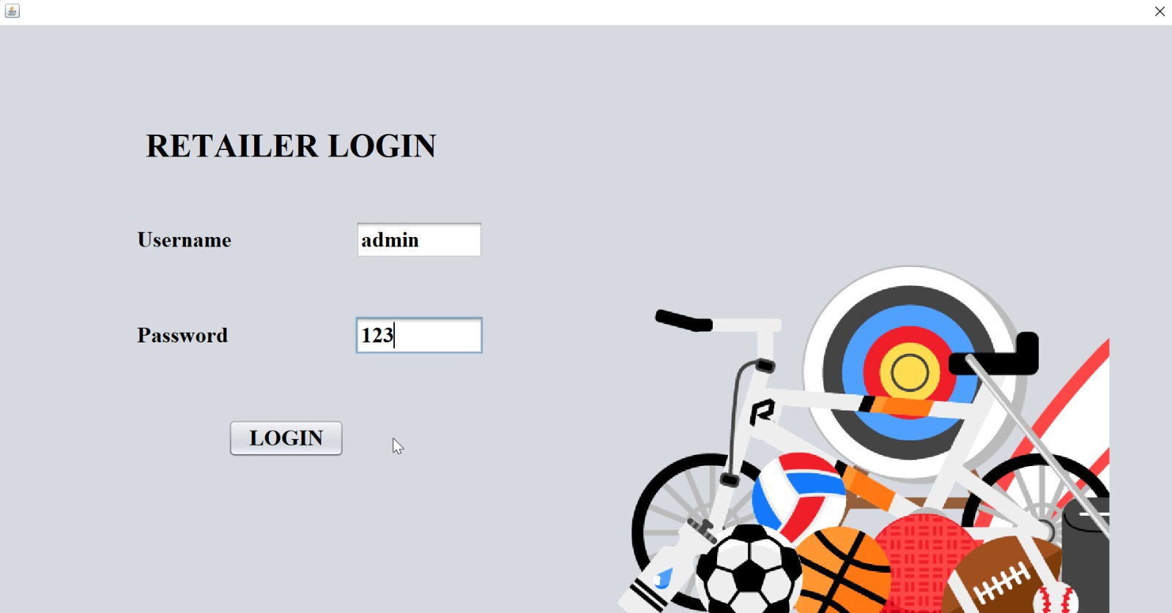
Login Page

Slide 9
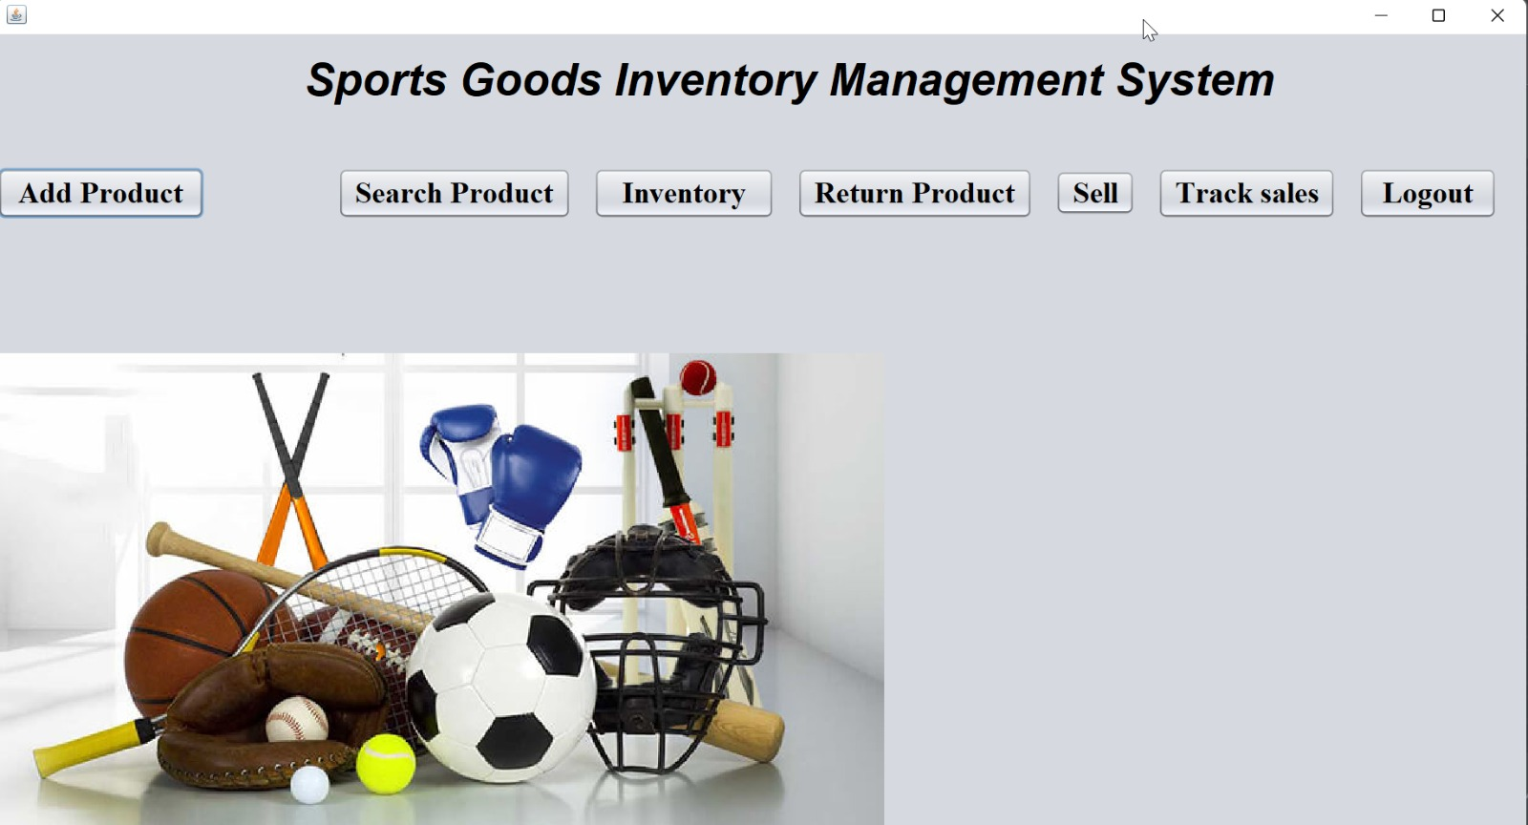
Main Menu

Slide 10
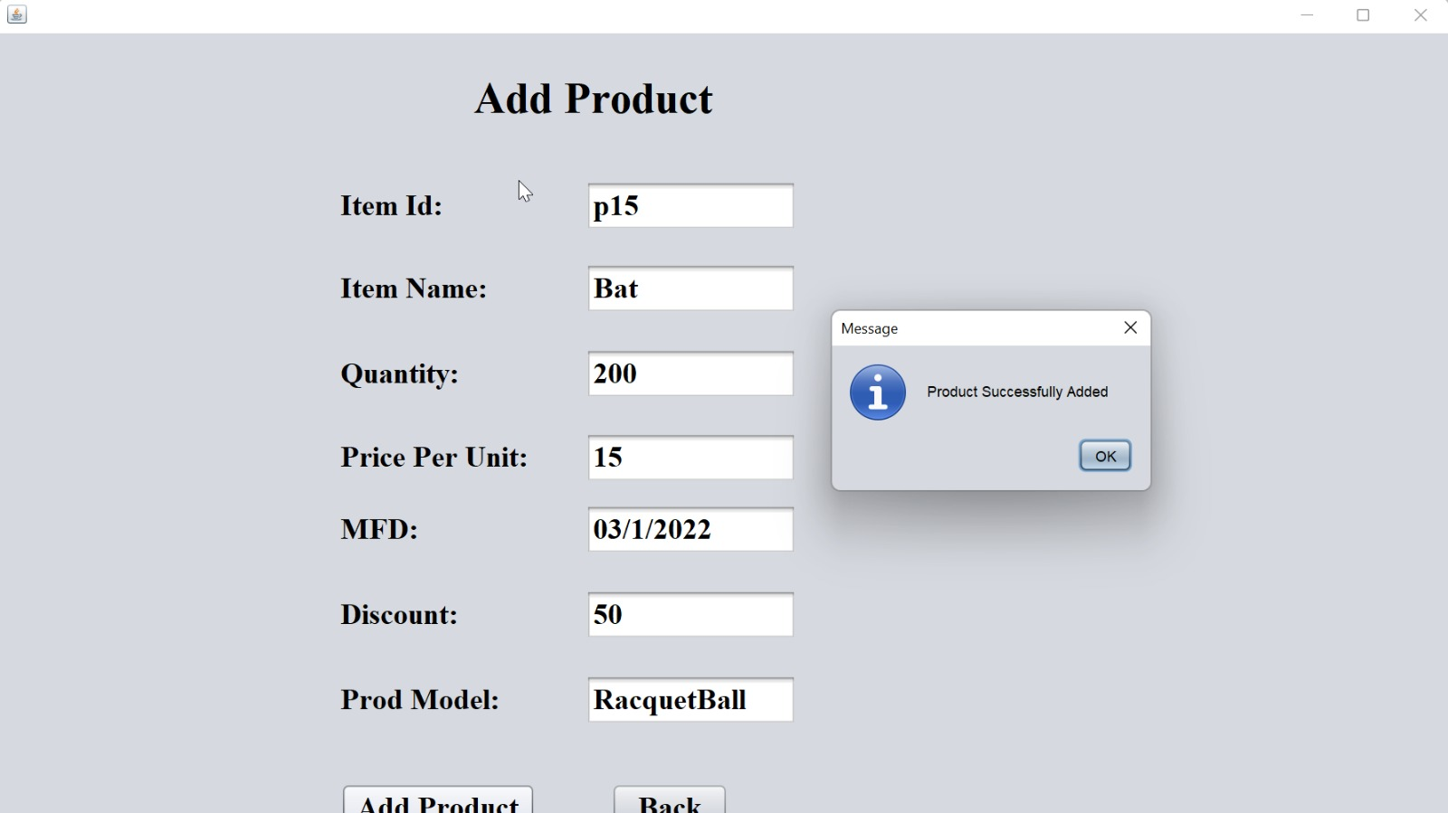
Add Product

Slide 11
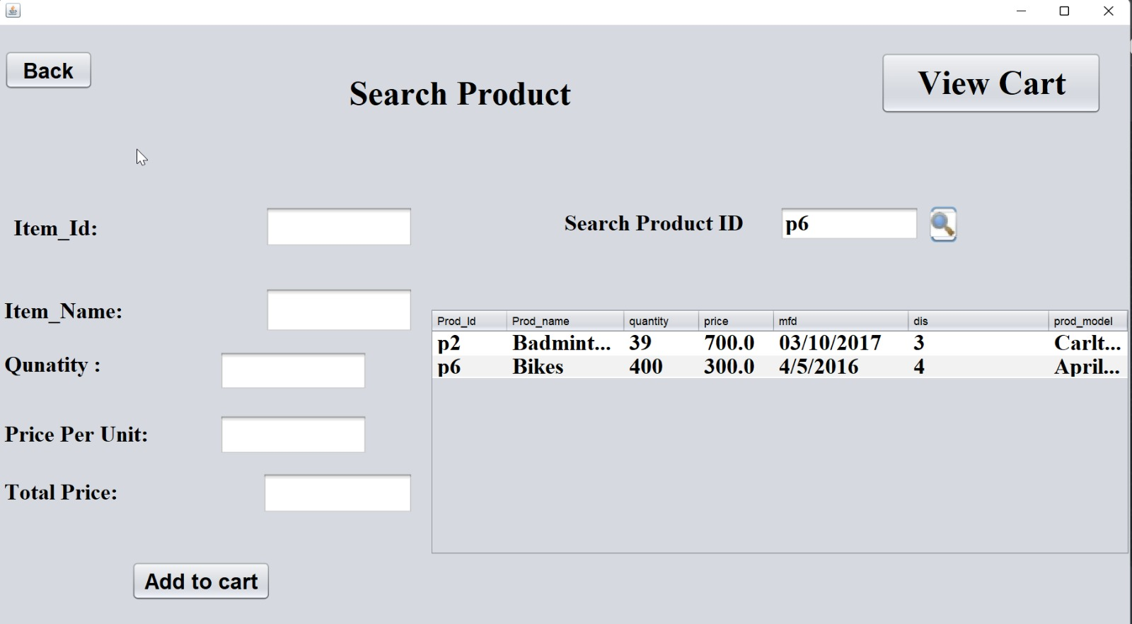
Search Product

Slide 12
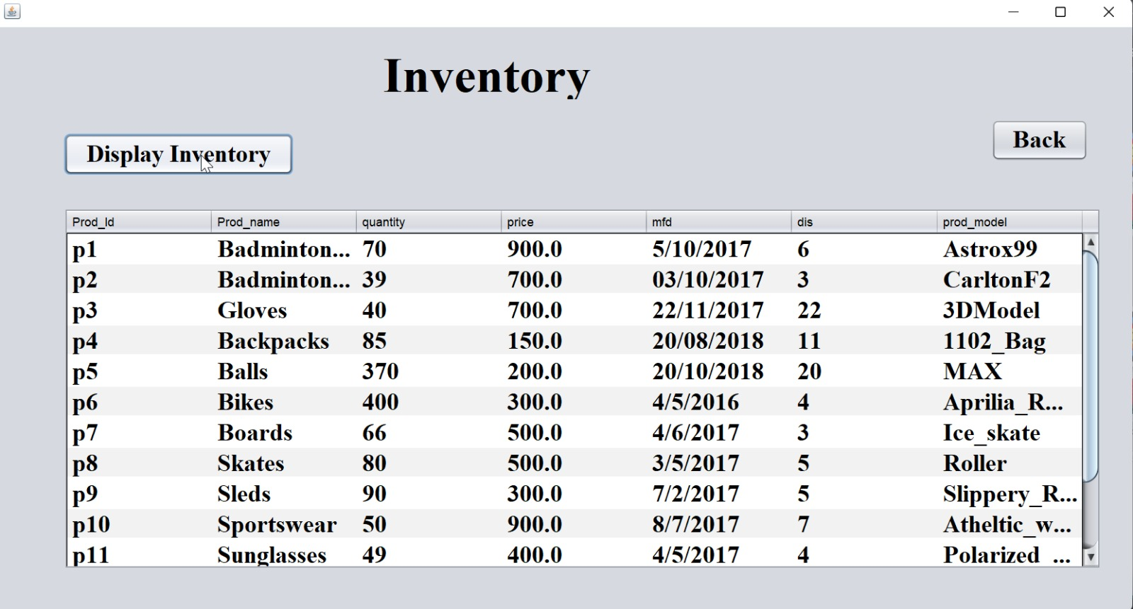
Display Inventory

Slide 13
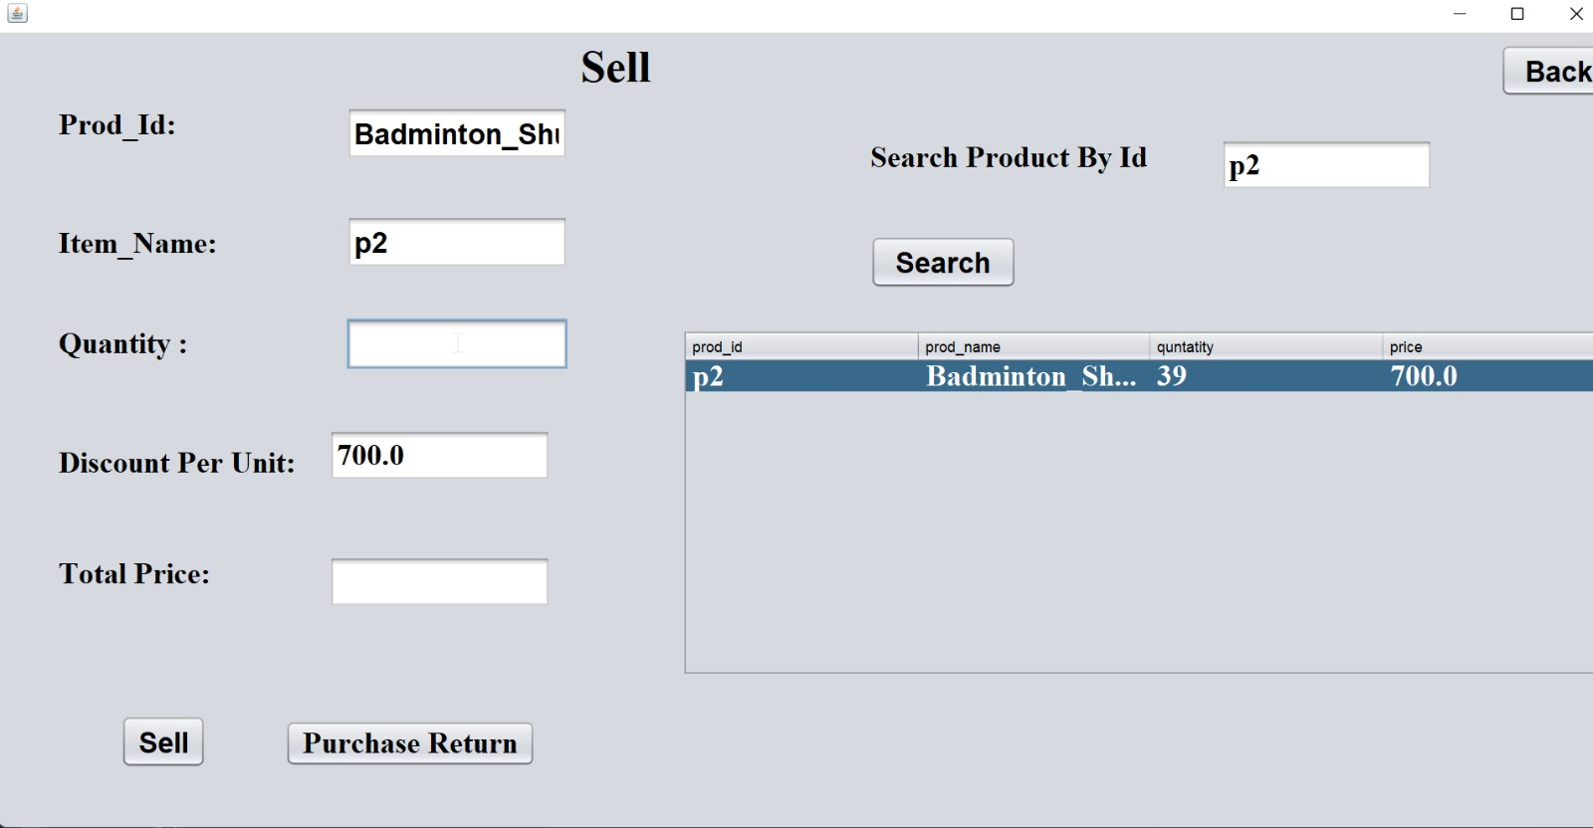
Delete Product

Slide 14
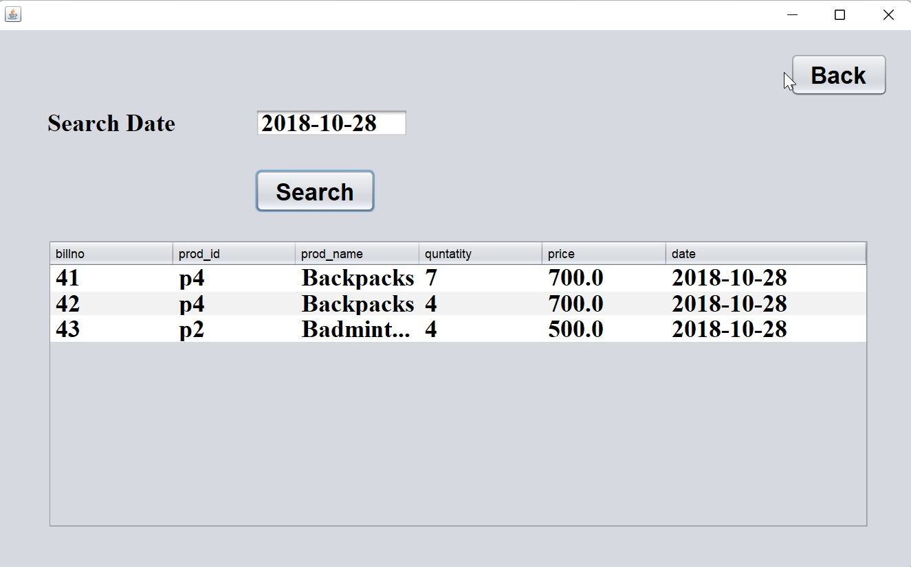
Track Sales

Slide 15
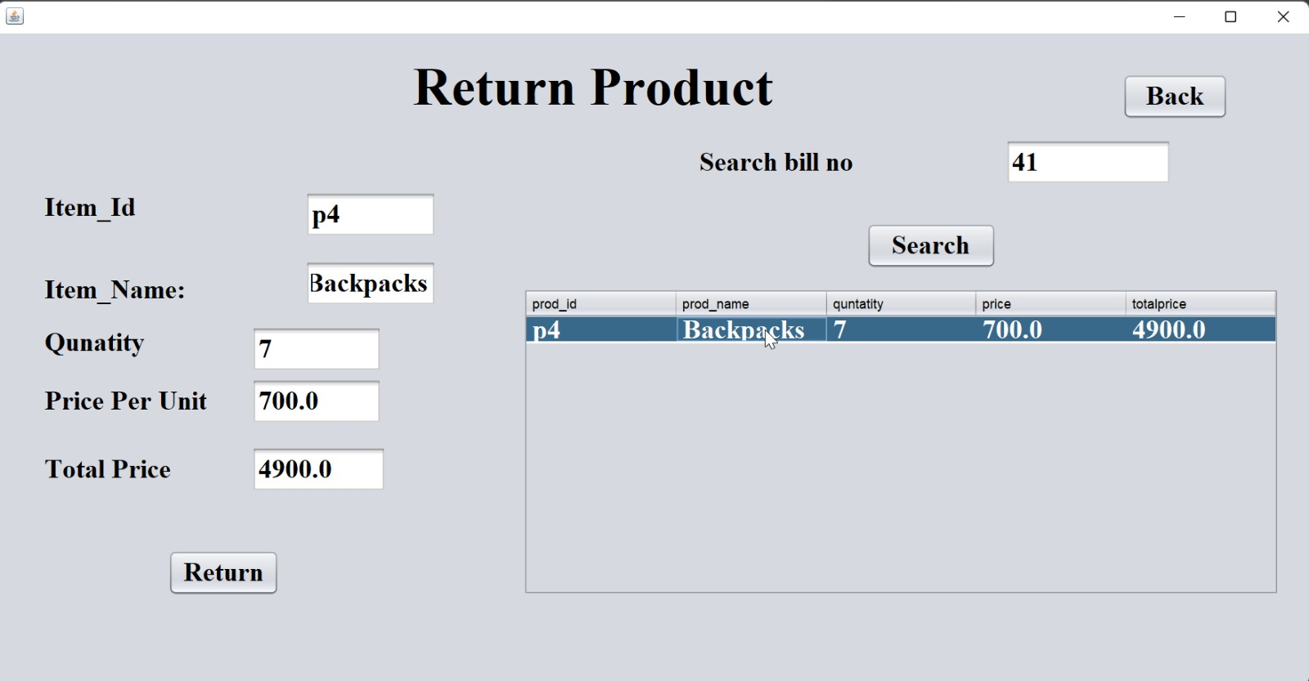
Return Product

Slide 16
Problem Analysis
Decentralized design
Misplaced inventory items
Quality of data
Interface problems
Training
Security
Product criteria

Slide 17
Additional Features added since HW4
Implemented return product, sell product, and track sales
Developed and integrated user-friendly GUI

Slide 18

Self Evaluation
Challenges Faced:
1. Designing the GUI
2. Understanding of Java Swing and GUI in limited time
3. Integration of all the inventory operations
4. Code Compilation

Slide 19

Thanks
Any Questions?

